Slide 1

Client Connect

Slide 2
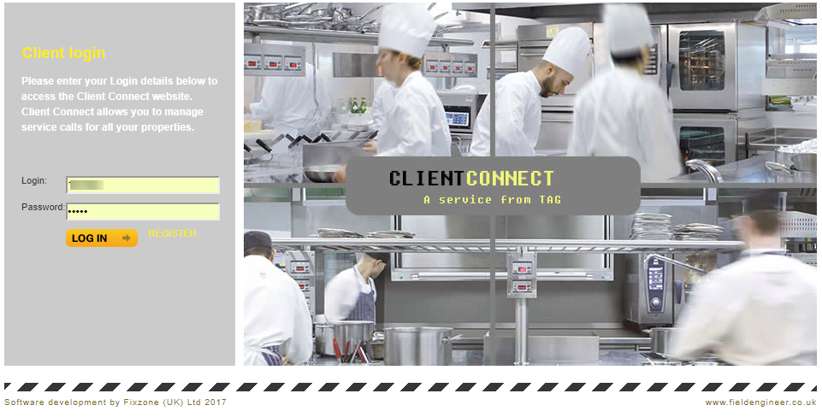
Login with the credentials supplied.
Notes:
Login with the credentials supplied.

Slide 3
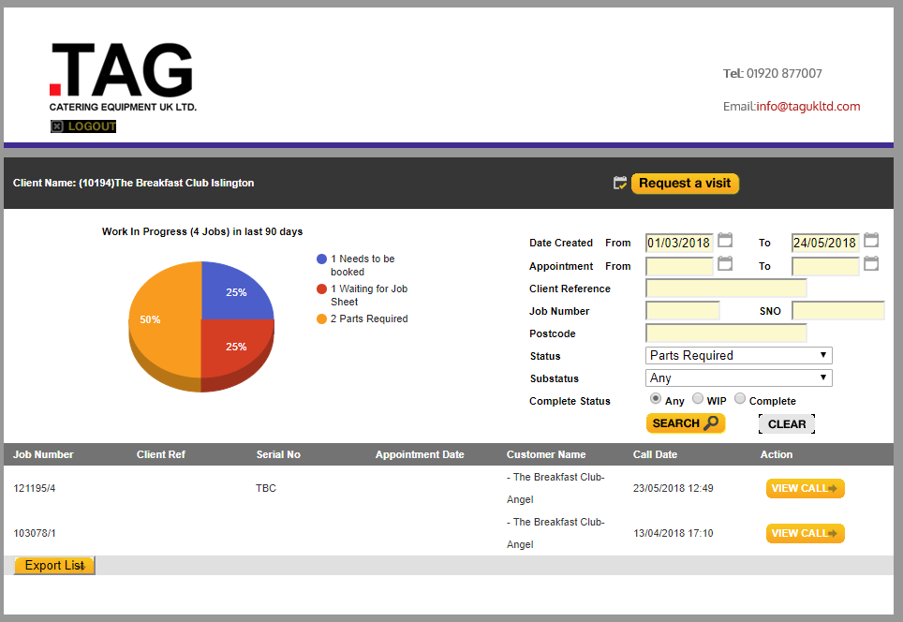
The main screen allows you to view calls and you can search for a call by Date Range, Status, Job Number, Client Reference etc. Clicking on the View Call button will open up the call details in a separate window.
Notes:
The main screen allows you to view calls and you can search for a call by Date Range, Status, Job Number, Client Reference etc. Clicking on the View Call button will open up the call details in a separate window.

Slide 4
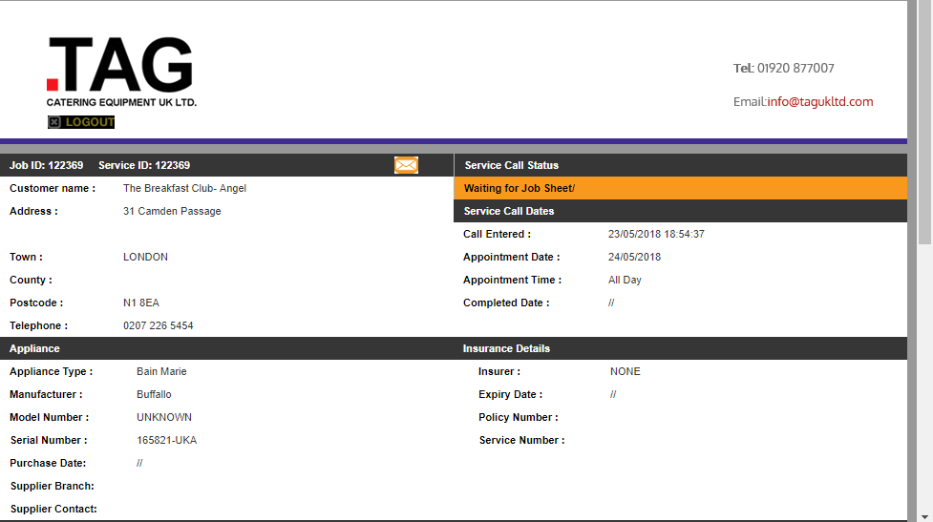
This shows all of the details of the Service Call.
Notes:
This shows all of the details of the Service Call.

Slide 5
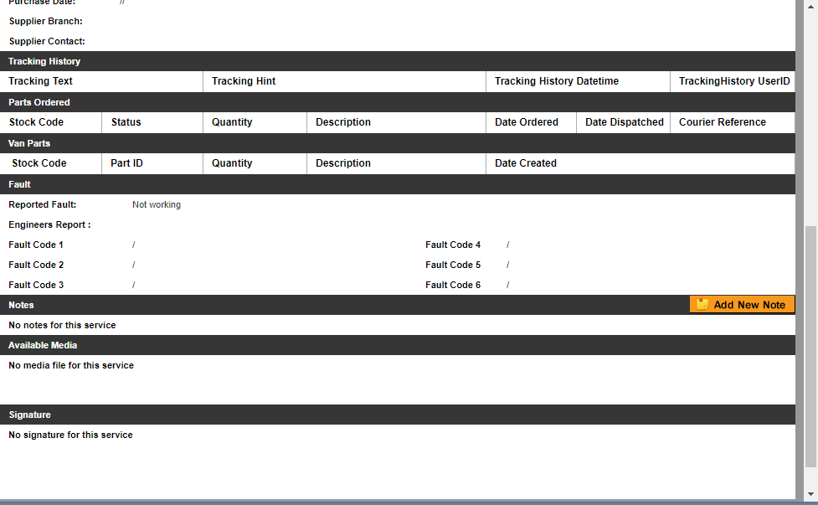

Slide 6
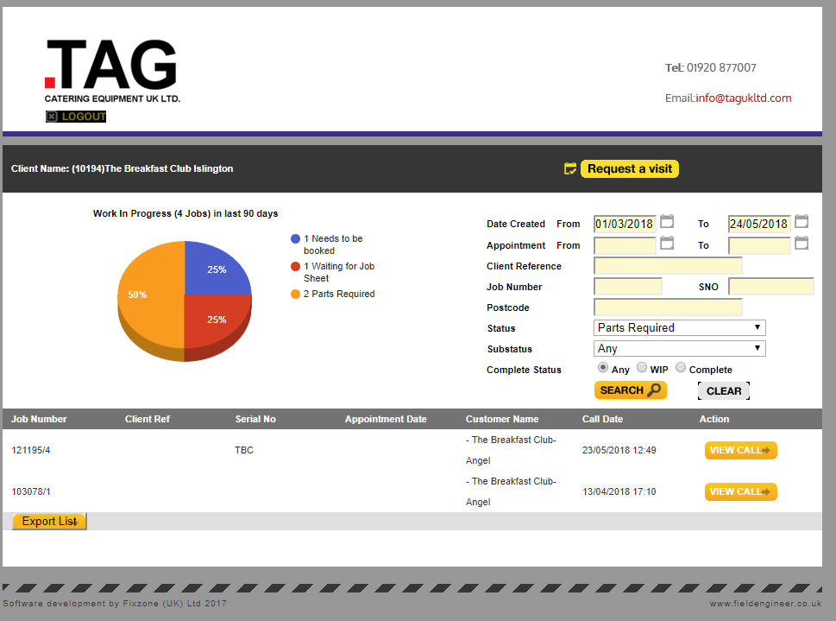
Clicking on the Request a visit will allow you to book a new Service Call.
Notes:
Clicking on the Request a visit will allow you to book a new Service Call.

Slide 7
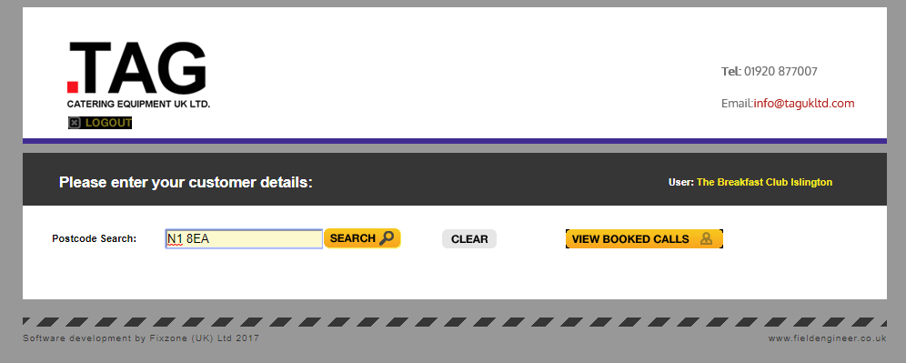
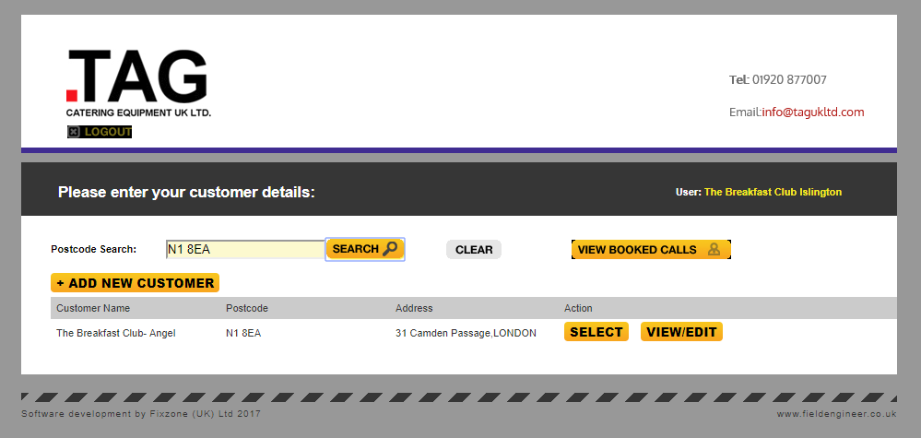
Enter the Postcode and click on the search button. Select the customer from the list displayed.
Notes:
Enter the Postcode and click on the search button. Select the customer from the list displayed.

Slide 8
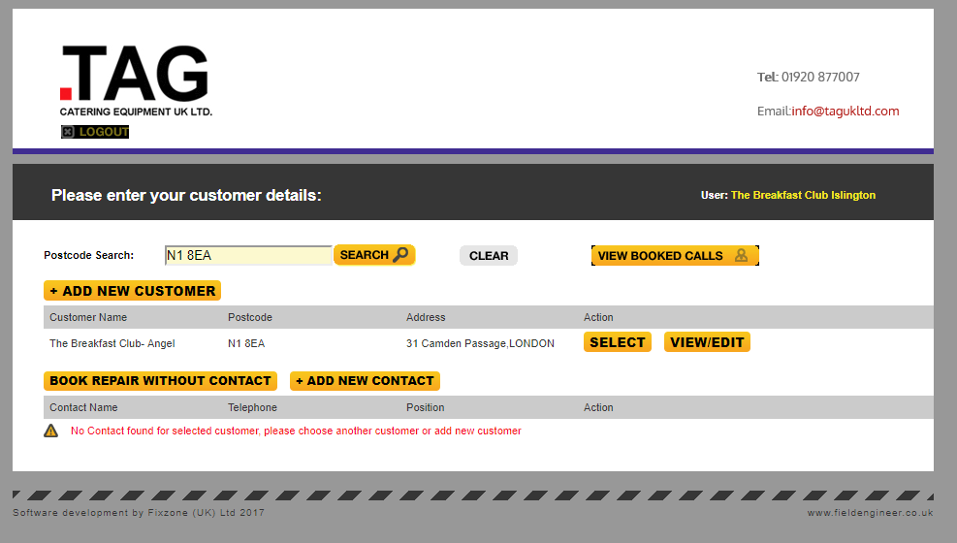
If there are no contact details available you can either chose to add them or continue without.
Notes:
If there are no contact details available you can either chose to add them or continue without.

Slide 9
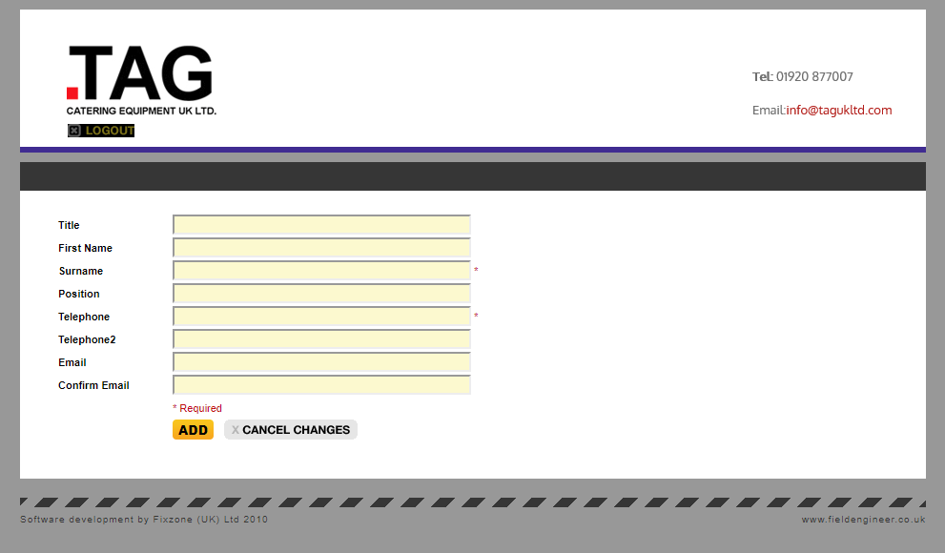
Add contact details if required and click on the Add button to save the details.
Notes:
Add contact details if required.

Slide 10
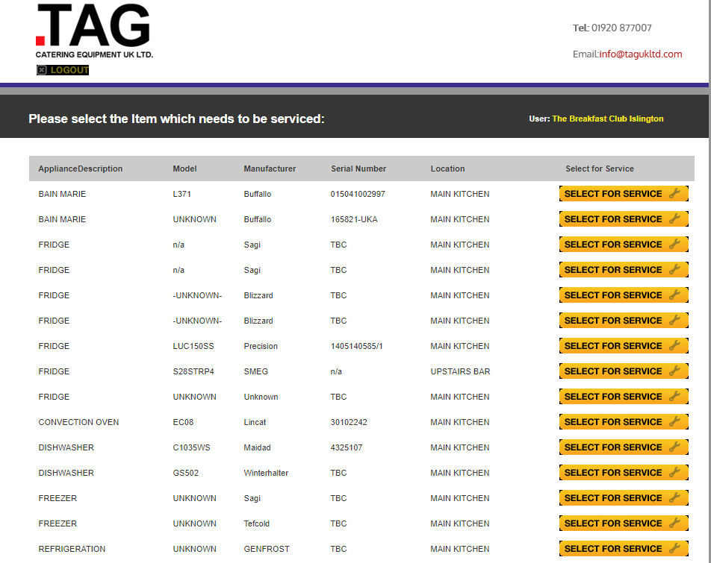
Select the appliance for repair from the available list.
Notes:
Select the appliance for repair from the available list.

Slide 11
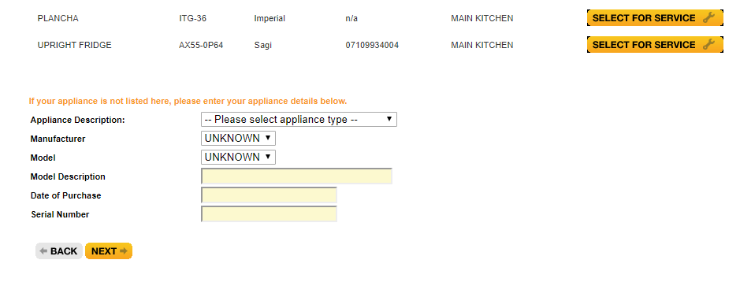
Or add the details of a new appliance if it is not listed.
Notes:
Or add the details of a new appliance if it is not listed.

Slide 12
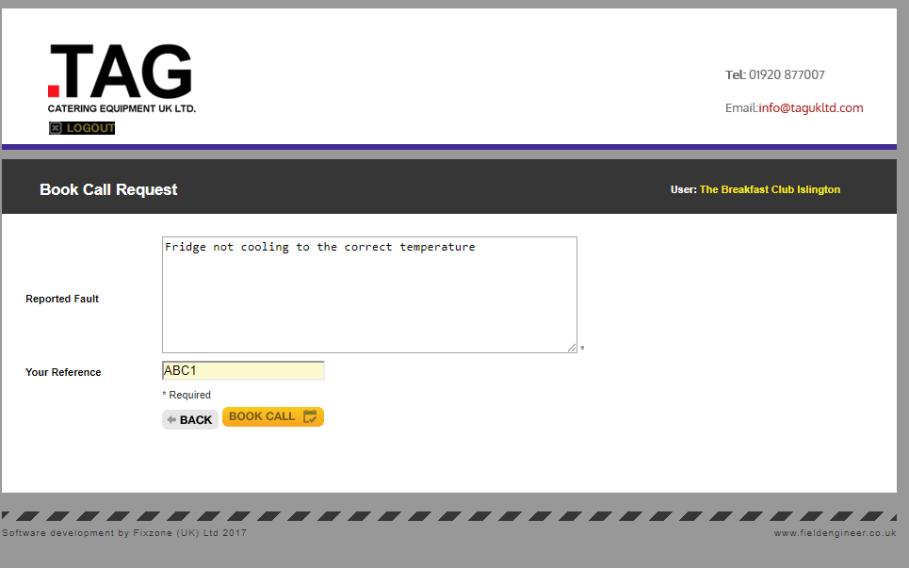
Enter the details of the fault and a reference number and click on the Book Call button.
Notes:
Enter the details of the fault and a reference number and click on the Book Call button.

Slide 13
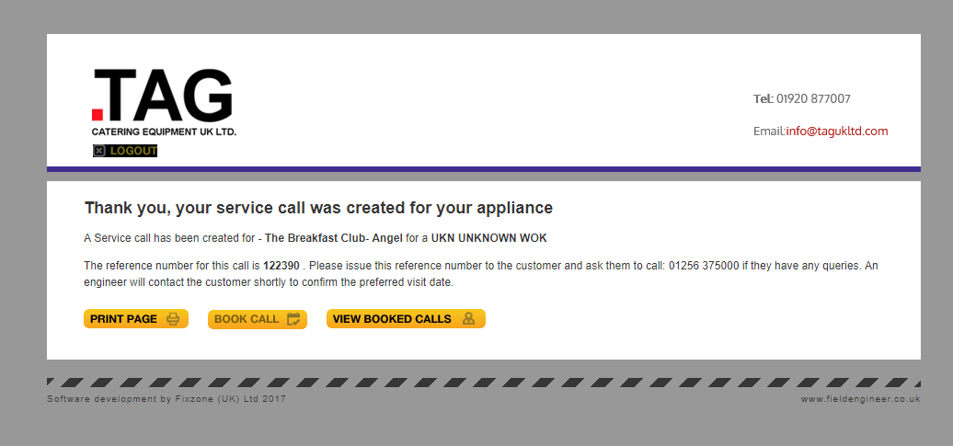
You will then receive a confirmation and reference number for the service request.
Notes:
You will then receive a confirmation and reference number for the service request.

